Slide 1
Survey of Post Last Glacial Maximum Environment: Unusual soil Constituents in Rockyhock Bay stratigraphy
Kiara Jones (SAC)
Ryan Lawrence (ECSU)
Mentor: Dr. Malcolm LeCompte (ECSU)

Slide 2
Abstract
Throughout North America’s eastern coastal plain are found a variety of features attributed to ice age climate. These include many elliptical, shallow depressions collectively called Carolina Bays, hypothesized to have been formed by the strong, sustained winds and arid, cold climate characteristic of glacial epochs (Raisz, 1934, Johnson, 1942 and Kaczorowski, 1977). This view eclipsed the 1933 proposition by Melton and Schriever, and expanded by Prouty (1934, 1953), that extraterrestrial debris produced by an aerial meteorite or comet explosion in the vicinity of the Great Lakes during the late Pleistocene formed the bays. Recent discovery that a number of the bays were found to contain material associated with extraterrestrial impacts including carbon and magnetic spherules, glass-like carbon, charcoal and nanodiamonds reinvigorated the debate over the bay’s origins (Firestone, et. al. 2007).

Slide 3
Abstract
To confirm the bays were receptacles for impact material, soil samples were previously taken from Rockyhock Bay in Edenton, NC. Sequential soil samples were excavated near the bay’s center and core samples extracted near the bay’s rim. The samples were examined to determine the presence of carbon-associated markers and to measure the density of magnetic grains and grain-size distribution. Magnetic spherules were found among the smaller size portions of the magnetic grains and spherule density estimated. The geochemistry of a magnetic spherule was determined using scanning electron microscopic energy dispersive x-ray spectroscopy (SEM-EDS).

Slide 4
Keywords
Last Glacial Maximum (LGM)
Pleistocene-end
Carolina Bays
Slurry
Stratigraphy
Microtektite
Scanning Electron Microscope
Notes:
Last Glacial Maximum (LGM)- refers to the period in earth's history when the glaciers were at their thickest and the sea levels at their lowest approximately 20,000 years ago
Pleistocene-end – 2.6 million – 12,000 yrs BP; YD – 12,900 yrs BP ends
Carolina Bays-shallow, SE-NW oriented, elliptical depressions (may or may not be wetlands or lakes) surrounded by a low rim; Delaware - Florida
Slurry- mixture of soil samples and water
Stratigraphy- study of rock layers and layering
Microtektite- sub-millimeter –sized glassy spherules that are distal ejecta of meteorite impact events; unaltered impact glass produced during impact events from Cenozoic Era
Scanning Electron Microscope – an electron microscope that images the sample surface by scanning it with a high-energy beam of electrons in a raster scan pattern.

Slide 5
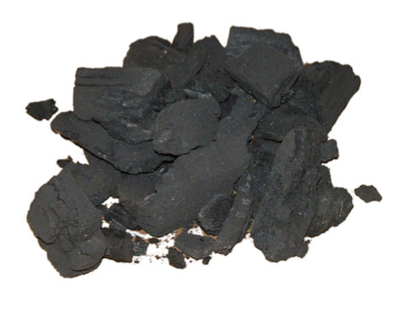
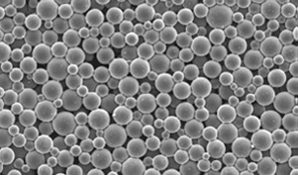
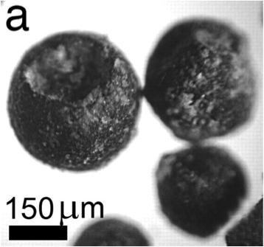
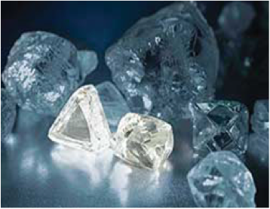
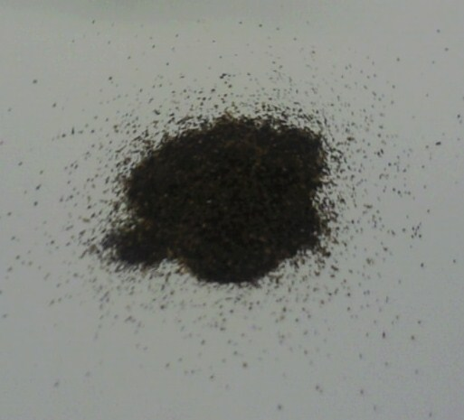
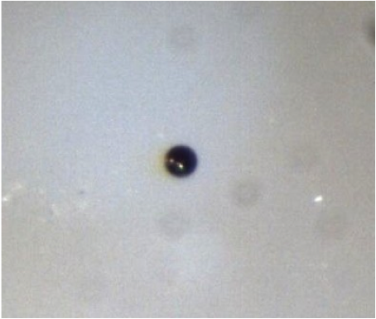
Evidential Markers: Soil Constituents
Charcoal
Glass-like Carbon
Carbon Spherule
Nanodiamonds
Magnetic Grains
Magnetic Spherule
Notes:
Charcoal
Glass-like Carbon
Carbon spherule
Frequently contain impact-nanodiamonds
A layer of enhanced magnetic grain density
Frequently contains magnetic spherules
Chemistry indicates possible micro-tektites

Slide 6
Statement of Problem
Do the same soil constituents exist in Rockyhock Bay sediment?
If so, can their source and significance be determined?
Notes:
Firestone et al. (2007), discovered that some Carolina Bays contain soil constituents interpreted as evidence of an extraterrestrial impact 12,900 years Before Present (B.P.)
Date Corresponds to
Megafauna extinction,
Clovis Culture disappearance
return to glacial climatic conditions known as Younger Dryas period;
persisted for 1,500 years.
Fireestone et al. evidence included:
Carbon-forms (interpreted as evidence of biomass burning)
Magnetic grains and microspherulites (source & significance unknown) ECSU 2009 URE Team discovered similar evidence in sediment from Kimbel Bay

Slide 7
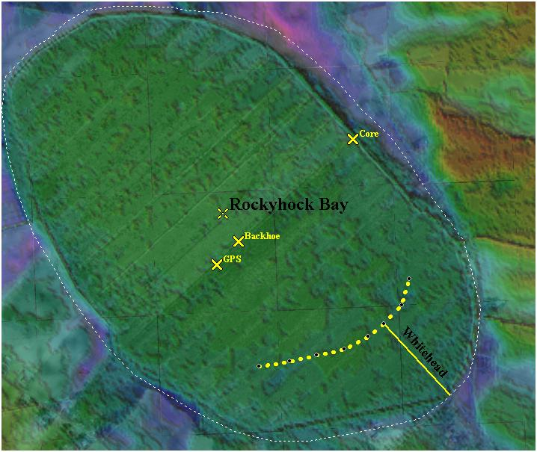
Rockyhock Bay: Soil Sample Source
* Barnes & Hall URE OMPS 2009
Notes:
Classic Large Carolina Bay
Elliptical Shape
NW-SE Orientation
Raised Rim
Existed as a Holocene lake and eventually wetland-swamp
Studied by Whitehead (1980)
Correlated depth to date
Barnes & Hall (2009) performed GPR Survey
Soil core samples taken from near the bay rim
Soil samples were taken from a Backhoe excavated pit near bay center.
Discovered bottom conformal iron rich layer confirming wet history

Slide 8
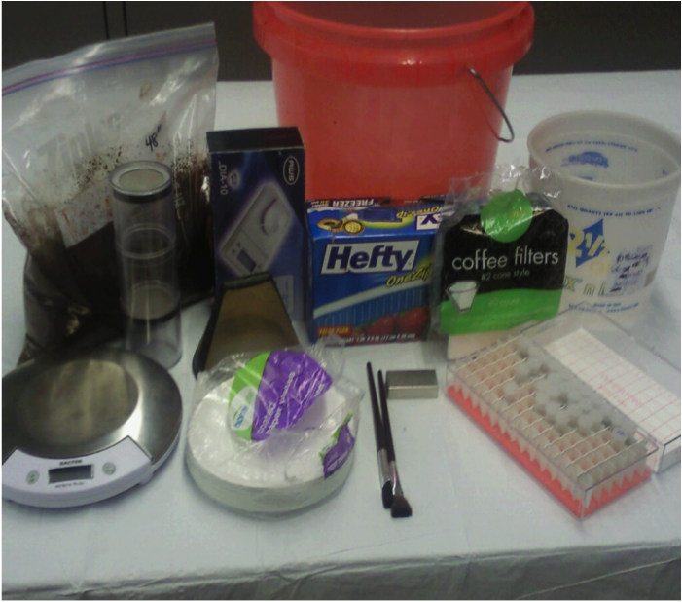
Analysis Materials
Digital 1 gram Scale

Slide 9
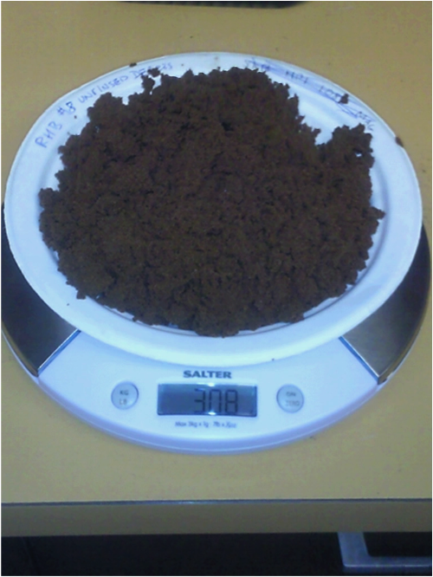
Soil Processing
A 300 gram aliquot was extracted from each sample.
Samples were mixed for homogeneity prior to extraction.
Notes:
RHB core samples were taken at 6 inch intervals.
Sample was selected and put into a bucket of water to create a slurry.

Slide 10
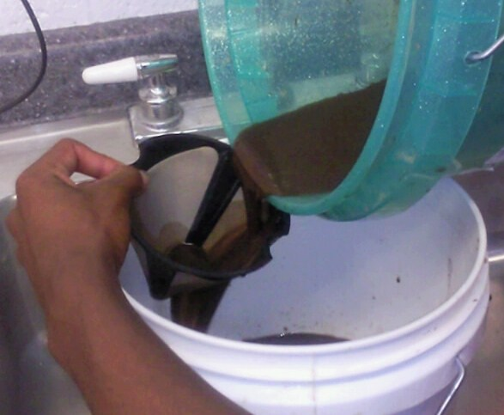
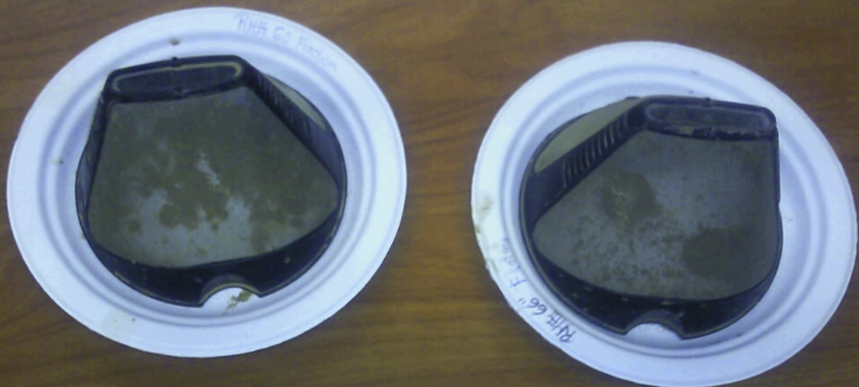
Extraction of Floating Material
Notes:
filtered by pouring the slurry back and forth between 12 liter containers multiple times.
Floating material was caught using a 20 μm gold-screen filter.
Gold-screen filters were placed on a plate to dry, and later examined.

Slide 11
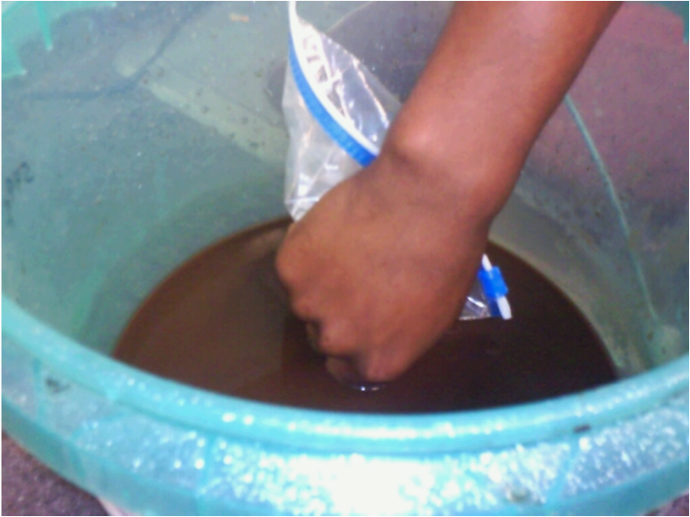
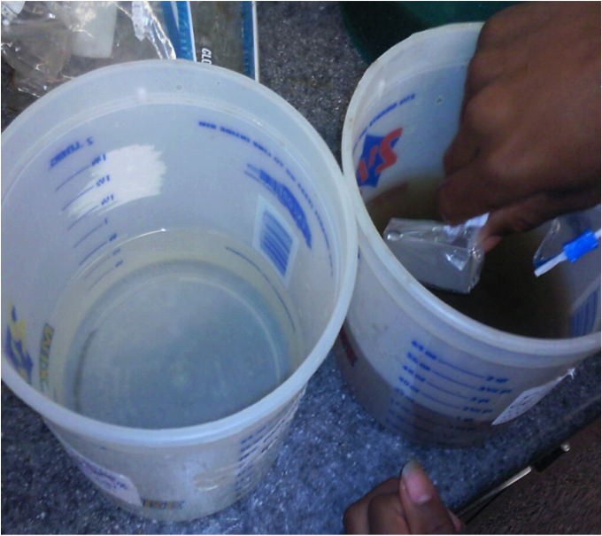
Extraction and Rinsing of Magnetic Grains
Notes:
A NdFeB-N50 Magnet was placed into a plastic bag to extract the magnetic material.
The bag was placed into the slurry where it was slowly moved around.
This was performed 14 times for 45 seconds each to ensure consistency.

Slide 12
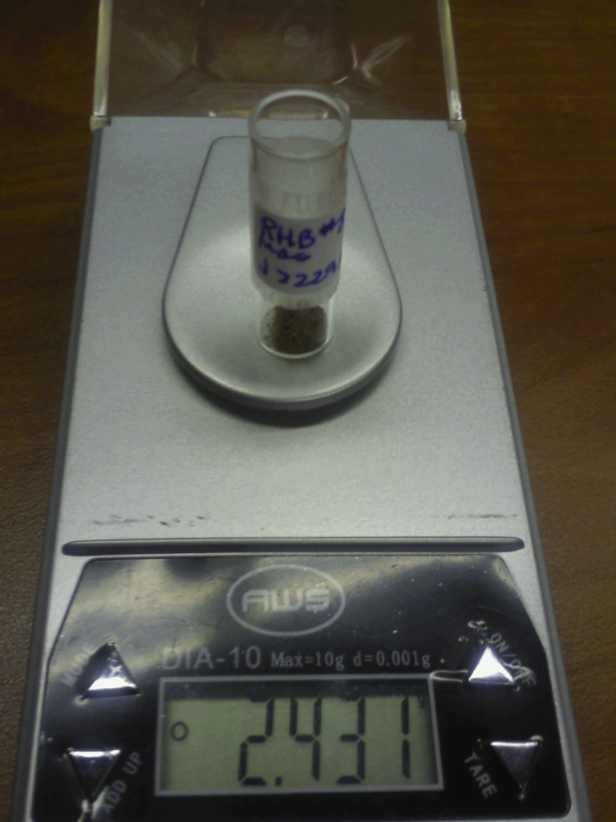
Weighing Magnetic Grains
Hitachi S-3200N SEM
Notes:
The water from the rinsed magnetic fraction was filtered using a coffee filter and gold-screen filter.
The magnetic grains were left to dry, and were measured.
Density calculations were also made.

Slide 13
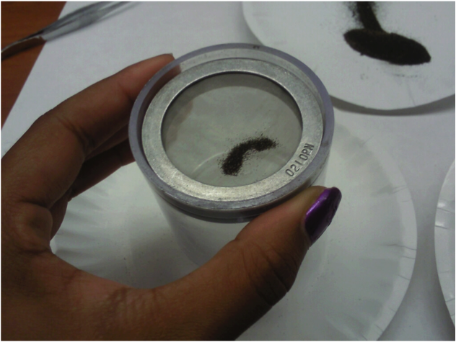
Size Sorting of Magnetic Grains
Keck Sand-Shaker Sieve
Notes:
Bulk grain material containing peaks were separated into 3 sizes: d > 250 µm, 53 µm < d < 250 µm, and 53 µm > d.
The 3 size portions were put into glass vials and their mass was measured.

Slide 14
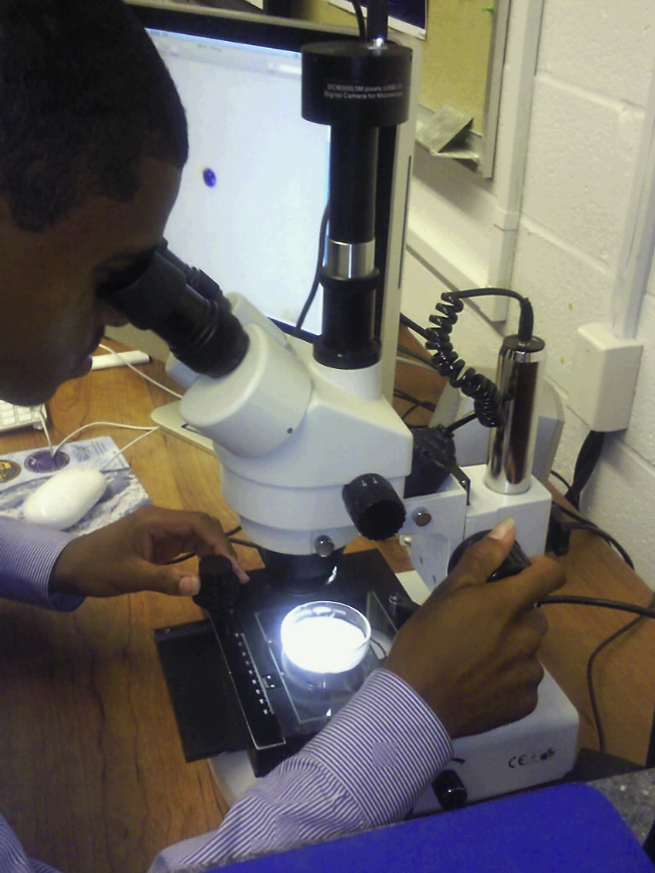
Analysis of Magnetic Grains
Notes:
Petri dishes containing 10-30 milligrams of the 53 μm < d magnetic fraction were scanned under an optical microscope.
Grains suspected to be spherules were examined at maximum magnification, and a photo was taken.
An one-stranded artist’s brush was used to extract the spherules to stubs.

Slide 15
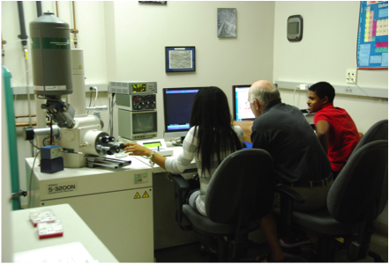
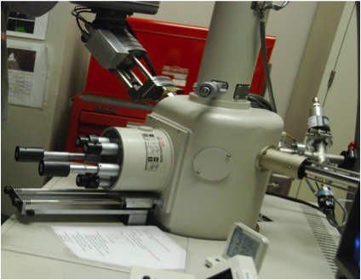
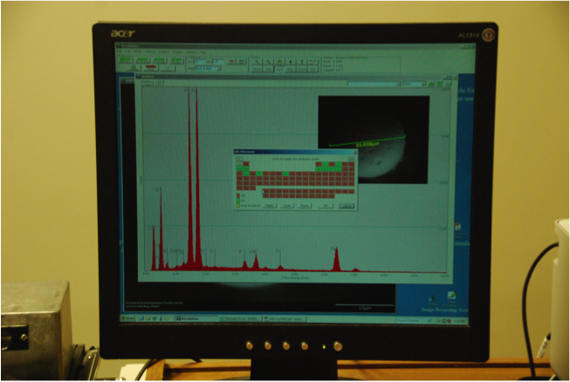
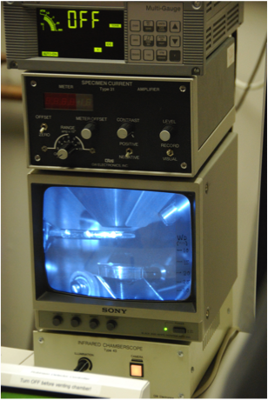
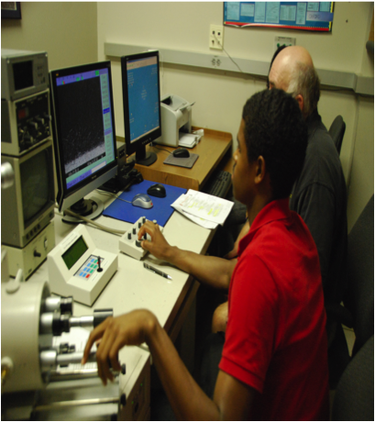
Scanning Electron Microscope (SEM)
Hitachi S-3200N SEM
Notes:
The Hitachi S-3200N SEM was used to examine magnetic material from 24’’ and 48’’ depth

Slide 16
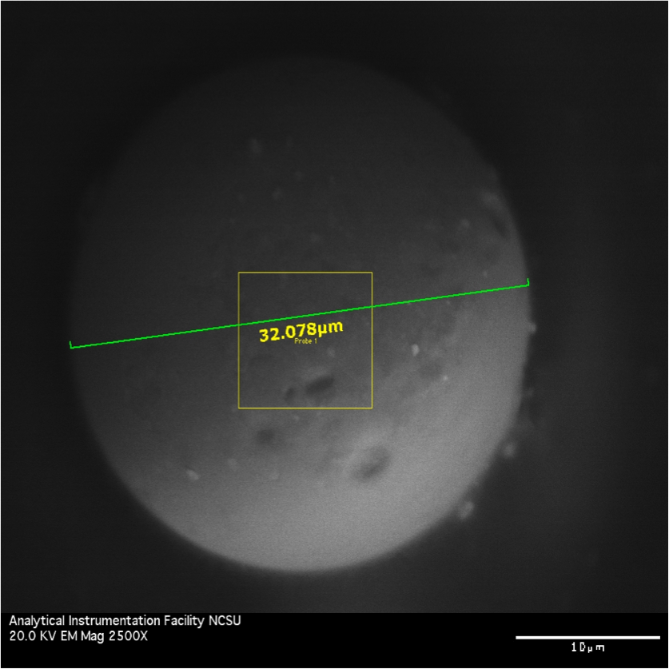
SEM Image
Magnetic spherule from sample-depth 48”

Slide 17
SEM: Energy Dispersive X-Ray Spectroscopy

Slide 18
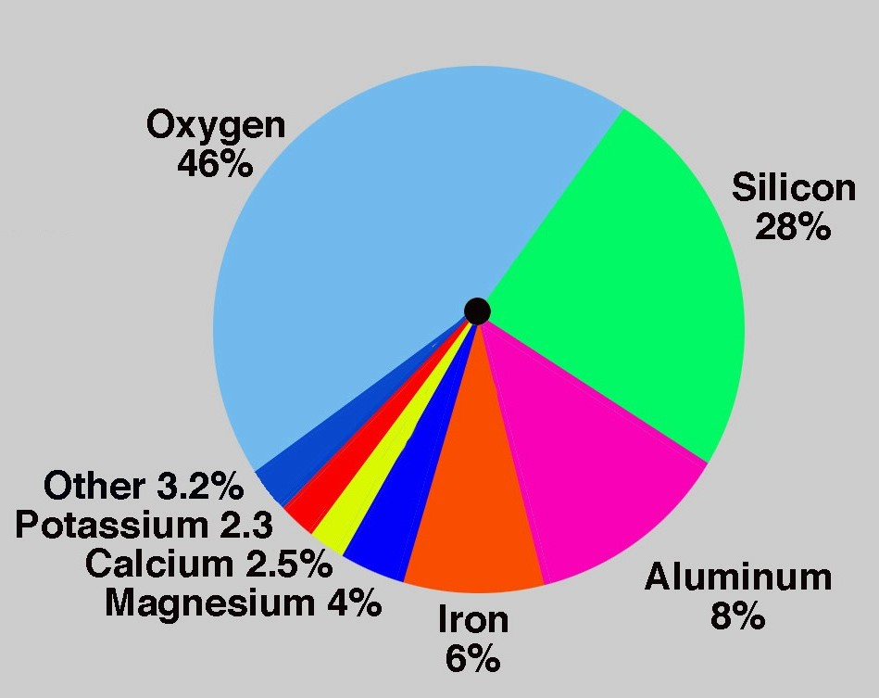
Comparison of the Geo-chemical Composition to Earth’s Crust
Geo-chemistry of Magnetic Spherule (48”)
Elements | Percent (%)
Oxygen | 29.9
Silicon | 16.54
Aluminum | 14.83
Iron | 3.05
Magnesium | 0.42
Calcium | 1.02
Potassium | 0.57
Earth’s Crust Composition

Slide 19
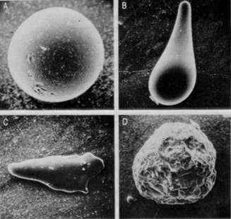
Microtektite Formation: Terrestrial Impact Theory
Notes:
Terrestrial impact theory
The terrestrial-impact theory states that a meteorite impact melts material from the Earth's surface and catapults it up to several hundred kilometers away from the impact site. The molten material cools and solidifies to glass. According to this theory, a meteorite impact causes their formation, but the precursor material of tektites is primarily of terrestrial origin, as determined from isotopic measurements. Today, the terrestrial origin of tektites is widely accepted based on the results of many geochemical and isotopic studies (e.g. Faul H.(1966), Koeberl C.(1990)).

Slide 20
Results

Slide 21
Results
Peak Depths (cm) | Mass of Magnetic Grains (g/kg) | Mass of Smallest Magnetic Grains (d < 53 μm) (g/kg) | Percent of Smallest Magnetic Grains
61 | 11.914 | 0.057 | 0.48%
91.4 | 9.473 | 0.127 | 1.34%
121.9 | 10.313 | 0.297 | 2.87%
152.4 | 10.070 | 0.197 | 1.96%

Slide 22
Results

Slide 23
RHB Results Compared to other Bays
Markers | RHB | Other Bays
Amber Spherules | small amounts | varying amounts
Carbon Spherules | none | varying amounts
Charcoal | small amounts | varying amounts
Glass-like Carbon | small amounts | varying amounts
Nano-diamonds | untested | varying amounts
Magnetic Grains (Peak) | multiple peaks | single & multi-peaked
Magnetic Spherules | small amounts | varying amounts

Slide 24
Conclusion
No significant indication of biomass burning
Multiple bulk magnetic grain peaks
Peak in magnetic grains d < 53 48’ depth
Magnetic spherules - 48” depth sample.
SEM confirmed spherulitic nature
Indicated similar geo-chemistry to other spherules taken from distant sites.

Slide 25
Future Work
Do same SEM-EDS analysis done for Kimbel Bay magnetic spherules
Take a new core sample from just inside the bay!!
Find and survey other bays with similar Lacustrine-history.
Notes:
Soil samples analyzed from Rock Hock Bay contained soil constituents thatcorrelate with an extraterrestrial impact.
Further research should be done by taking new core samples from just inside of the bay. It is also suggested that core samples
at 7.6 cm intervals beginning at 61 cm to 167.6 cm to confirm the YD impact layer and obtain more accurate results.
The URE OMPS 2009 Gambit Team previously took and analyzed soil samples from Sandra Kimbel Bay (SKB).
It is recommended that processed samples from (SKB) with peaks in bulk magnetic grain density are size sorted (d >250 µm, 53 µm < d < 250 µm, and d < 53 µm) and calculate the percentages of each.
Afterwards, analyze the sample with the peak in d < 53 µm. Any possible spherules found should have the same SEM-EDS
work that was done on the spherules found in RHB. In doing so, the spherulitic nature and chemical composition of the possible
magnetic spherules can be determined.
Afterwards, those magnetic spherules should be compared to spherules from other impactsites.
Future Lacustrine-history bays should be surveyed and soil analyzed for impact markers including: charcoal, carbon
spherules, glass-like carbon, and magnetic spherules. If magnetic spherules are found, SEM-EDS should be performed. If carbon
spherules are found, Transmission Electron Microscopic (TEM) analysis should be performed to reveal the presence of
nanodiamonds should be performed.

Slide 26
Acknowledgements
Dr. Linda Hayden
Dr. Malcolm LeCompte
Rob’t Langenburg
Chuck Mooney and North Carolina State University

Slide 27
References
Barnes, LaEsha & Hall, Cedric, “The Carolina Bays: An Investigation of North America’s Post Last-Glacial Maximum Environment (LGM),” 2009
Glass, B.P., “Microtektite Surface Sculpturing,” in Bulletin of the Geological Society of America, vol. 85 no. 8, 1974
Koeberl, Christian, “The Geochemistry of Tektites: an overview,” in Annual Review of Earth and Planetary Sciences, vol. 14 no. 1, 1986
R.B. Firestone, A. West, J.P. Kennett, L. Becker, T.E. Bunch, Z.S. Revay, P.H. Schultz, T. Belgya, D.J. Kennett, J.M. Erlandson, O.J. Dickenson, A.C. Goodyear, R.S. Harris, G.A. Howard, J.B. Kloosterman, P. Lechler, P.A. Mayewski, J.Montgomery, R. Poreda, T. Darrah, S.S. QueHee, A.R. Smith, A.Stich, W. Topping, J.H. Wittke, and W.S. Wolbach, “Evidence for an extraterrestrial impact 12,900 years ago that contributed to the megafaunal extinctions and the Younger Dryas cooling,” in PNAS , vol . 104 no. 41, 2007, pp 2-4
Whitehead, Donald, “Late-Pleistocene Vegetational Changes in Notheastern North Carolina,” in Ecological Mongraphs,” in Ecological Society of America, vol. 51 no. 4, 1981, pp. 451–471.

